Slide 1
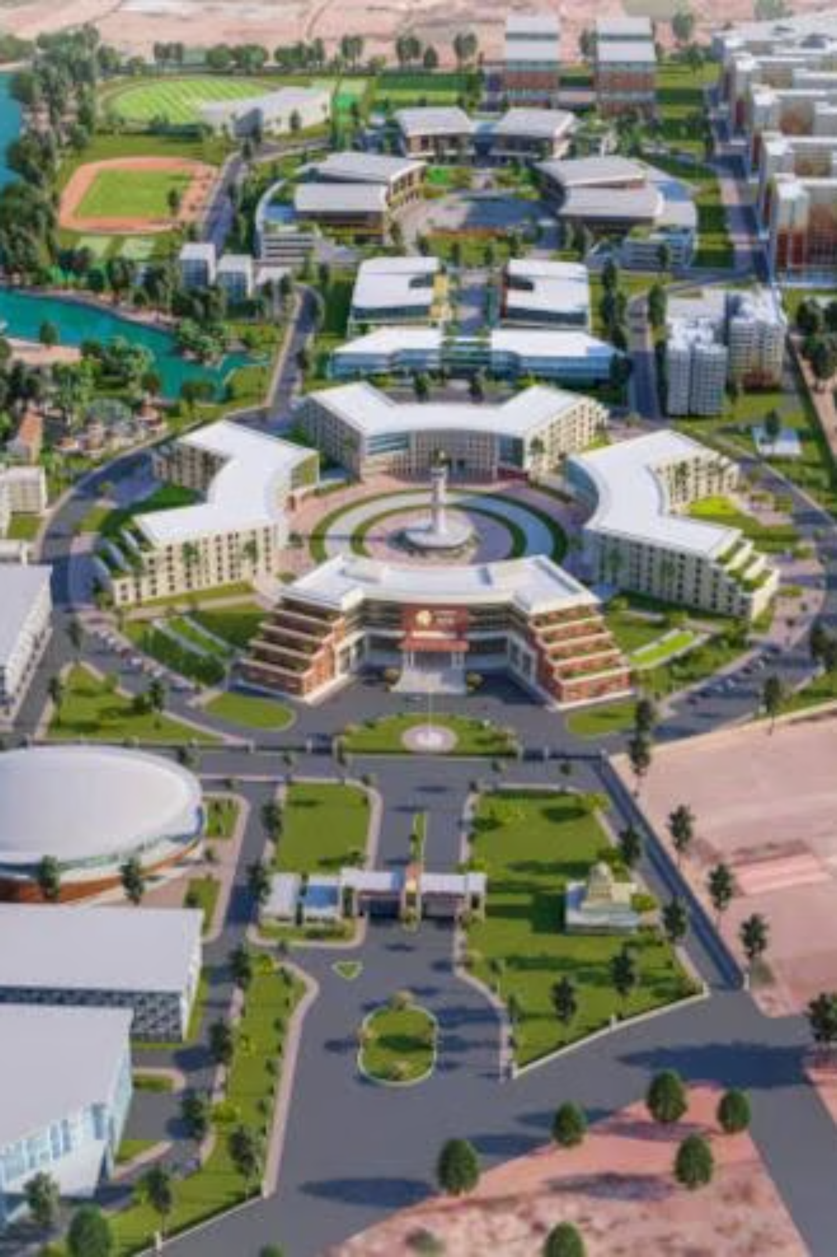
BotBrain: Campus Navigator
BotBrain Assignment Final Report
Submitted by
Thanushree G M
24UG00562
'B'- Section

Slide 2
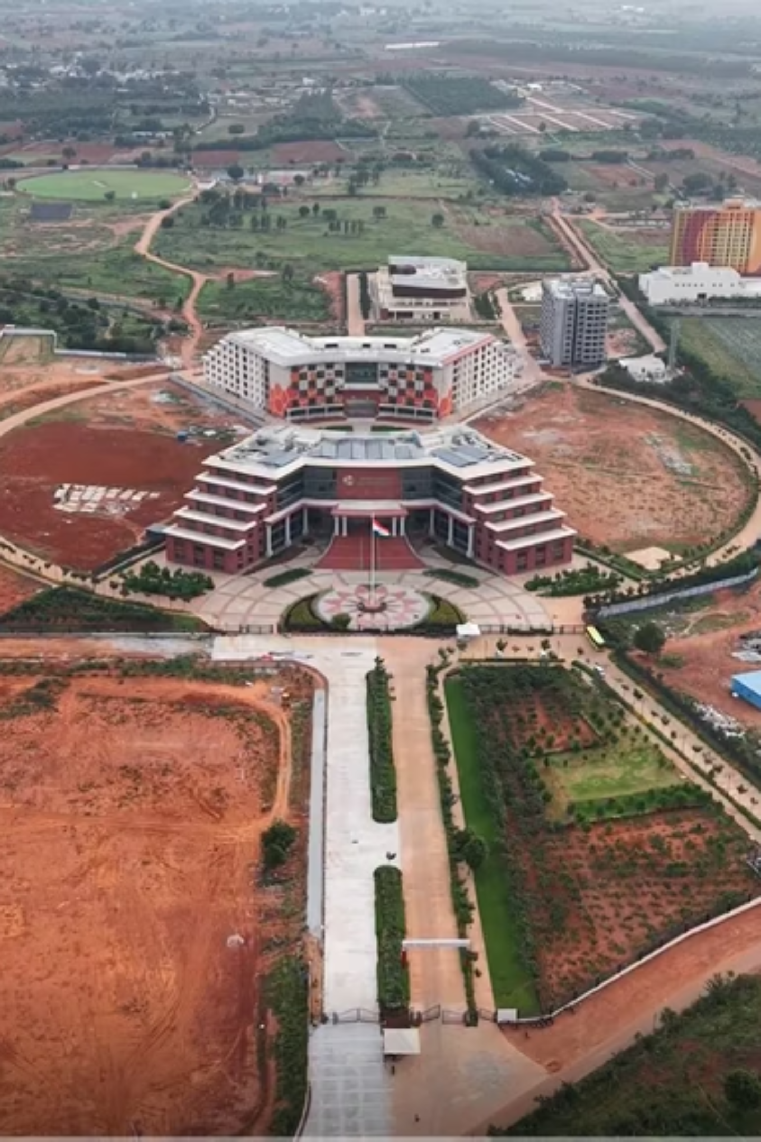



BotBrain: Enhancing Campus Navigation
BotBrain is an campus navigation system designed to facilitate easy and effective roaming within Chanakya University. It transforms the campus into a dynamic graph, where key buildings are represented as nodes and walkable routes as weighted edges.
Intelligent Pathfinding
User-Friendly Interface
Utilizes advanced search algorithms for optimal routes.
Intuitive web interface for easy interaction.
Visual Guidance
Projects paths onto aerial photos for clear understanding.

Slide 3
Problem Statement
Navigating through Chanakya University campus presents several significant challenges, leading to confusion and inefficiency for students, faculty, and visitors alike. BotBrain is designed to directly address these prevalent issues, transforming campus navigation into a seamless experience.
Getting Lost
Inefficient Routes
The sheer size and complex layout of the campus often result in individuals getting disoriented or lost, particularly for newcomers or those visiting unfamiliar departments.
Without clear, real-time guidance, users frequently take suboptimal or longer routes between buildings, wasting time and energy.
Time Wastage
Difficulty for Newcomers
The time spent searching for directions, rerouting due to confusion, or walking extra distances accumulates, impacting schedules and productivity for everyone on campus.
New students, visiting scholars, and first-time visitors struggle to quickly adapt to the campus environment, detracting from their initial experience and increasing stress.

Slide 4
BotBrain's Core Objectives
Project aims to provide a comprehensive navigation solution through several key objectives:
Digital Campus Mapping
Algorithm Implementation
User-Friendly Interface
Map buildings and paths as a weighted graph for precise route calculation.
Develop a web interface for easy input of start/destination
Implement BFS, DFS, UCS, and A* for flexible and optimal pathfinding.
Textual & Visual Guidance
Future Scalability
Provide detailed instructions, distance, time, and visual routes on an aerial map.
Ensure clarity for future enhancements, including real-time data and mobile platforms.

Slide 5
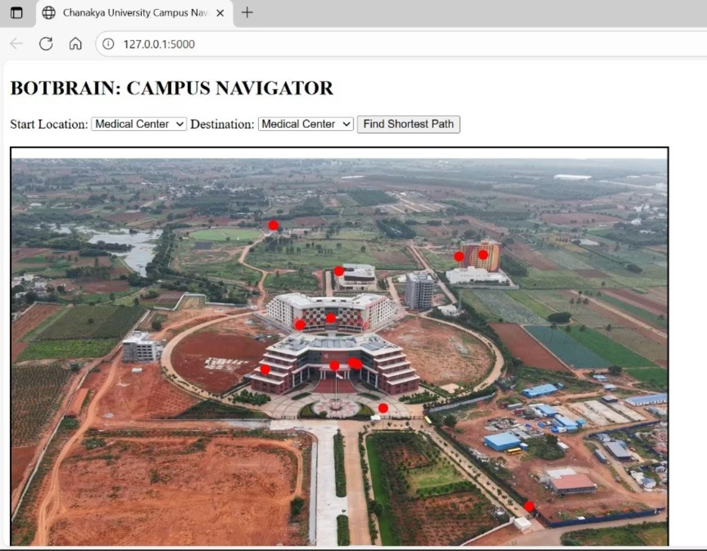
Scope of BotBrain
BotBrain is designed to deliver an accurate and efficient walking route solution for Chanakya University. Its scope encompasses:
Graph-based campus modeling
Multiple optimal pathfinding algorithms
Textual and visual navigation guidance
Interactive web interface
Coverage of major campus locations
Scalability for future expansions
This project aims to assist students, staff, and visitors while providing a
foundation for future smart campus applications.

Slide 6
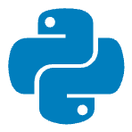




Tools and Technologies
Programming Language
Web Framework
Frontend Technologies
Python: The core programming language for algorithm implementation and backend logic.
Flask: A lightweight and flexible Python web framework that makes building web apps simple and fast.
HTML: Used to create the user interface and handle user interactions.
Pathfinding Algorithms
Data Structures
BFS, DFS, UCS, A*: Each algorithm contributes to finding optimal routes.
Graphs, Dictionaries: Graphs model the campus and dictionaries store building information.

Slide 7
Methodology & Implementation Details
Development process involved modeling the campus, implementing algorithms, and building a responsive web interface.
Campus Graph Construction
Buildings as nodes, paths as weighted edges, stored in Python modules.
Algorithm Implementation
DFS, BFS, UCS, and A* implemented in separate Python scripts.
Backend Development (Flask)
Handles user input, executes pathfinding logic, and sends results to frontend.
Frontend Interface (HTML/CSS)
User-friendly dropdowns for locations and algorithms; displays routes, distances, and times.
Route Visualization
Selected routes overlaid on an aerial campus image for clear graphical reference.

Slide 8





User Interface & Experience
Intuitive Dropdowns
Visual Route Maps
Effortless selection of start and end points for seamless navigation.
Routes clearly overlaid on campus maps for easy understanding and guidance.
Step-by-Step Guidance
Estimates at a Glance
Detailed, connection of nodes directions to ensure you never get lost.
Real-time distance and estimated time of arrival for efficient planning.
Seamless Across Devices
Optimized for desktop, tablet, and mobile, providing a consistent experience.

Slide 9



Testing & Validation
1
2
Algorithm Testing
Route Verification
Verified core pathfinding algorithms (BFS, DFS, UCS, A*) with sample routes.
Confirmed accurate identification of shortest paths between start and end points.
Interface Testing
Ensured all UI elements like dropdowns and buttons functioned correctly.

Slide 10
Conclusion & Future Directions
BotBrain successfully provides an efficient and accurate navigation system for Chanakya University. The interactive web interface and visual path overlay enhance usability, laying a strong foundation for future enhancements.
Current Success
Limitations
Future Scope
Optimal routes delivered via interactive web interface and visual map.
Current visualization directly connects nodes, lacking detailed walkable path curves.
Develop API for realistic walkable paths, enhance UI interactivity, and integrate with mobile platforms.

Slide 11

Thank You!

